Slide 1
MUTHUVEL S
Face Landmarks Detection
3/21/2024 Annual Review
1

Slide 2
PROJECT TITLE
Face Landmarks Detection
3/21/2024 Annual Review
2

Slide 3


3/21/2024 Annual Review
AGENDA
Problem Statement
Objective
Project Overview
Who is the end user
Model Used
Dataset
Result
Conclusion
3

Slide 4

Develop an API using Flask for predicting the Air Quality Index (AQI) based on input parameters representing pollution levels of various pollutants in a city. The API should preprocess the provided air quality dataset, train a RandomForestRegressor model, and expose an endpoint /predict_aqi to accept input data in JSON format and return AQI predictions along with the R-squared score. The API should include error handling and optional optimizations for deployment in a production environment.
PROBLEM STATEMENT
The accurate detection of facial landmarks is a crucial task in various computer vision applications, including facial recognition, emotion analysis, and augmented reality. Traditional methods often struggle with complex facial expressions, occlusions, and variations in lighting conditions. To address these challenges, our project aims to develop a robust deep learning model for facial landmark detection. By accurately localizing key points on the face, such as eyes, nose, and mouth corners, we seek to enhance the performance of facial analysis systems, ultimately improving user experience and enabling a wide range of innovative applications in diverse domains.
3/21/2024 Annual Review
4

Slide 5
Objective
Develop a Deep Learning Model: Design and train a convolutional neural network (CNN) architecture tailored for facial landmark detection, capable of accurately localizing key points on faces across various demographics and facial expressions.
Dataset Preparation: Collect and curate a comprehensive dataset of facial images with annotated landmark positions, ensuring diversity in ethnicity, age, gender, and facial expressions to enhance the model's robustness and generalization capabilities.
Optimize for Real-Time Performance: Implement optimizations to ensure the trained model can achieve real-time inference speeds, enabling seamless integration into applications such as live video processing and interactive user interfaces.
Evaluate Performance Metrics: Assess the performance of the developed model using standard evaluation metrics such as Mean Average Precision (mAP) and Mean Squared Error (MSE), quantifying its accuracy, robustness, and computational efficiency.
Address Occlusions and Variability: Investigate techniques to improve the model's robustness against occlusions, variations in lighting conditions, and facial expressions, ensuring reliable performance in diverse real-world scenarios.
Deploy and Validate: Deploy the trained model in practical applications and conduct extensive validation tests in real-world environments to ensure its effectiveness and reliability, gathering feedback for further refinement and optimization if necessary.

Slide 6
PROJECT
OVERVIEW
This project aims to develop a deep learning model for detecting facial landmarks, enabling precise localization of key points on human faces. The project involves several key components and stages:
Data Collection and Preparation: The iBug 300W Large Face Landmark Dataset is utilized for training and evaluation. This dataset consists of facial images with annotated landmark positions. The data preprocessing involves parsing XML files containing image filenames and corresponding landmark coordinates.
Data Augmentation: Various data augmentation techniques are applied to enhance model generalization and robustness. These techniques include rotation, resizing, color jittering, and cropping to focus on facial regions.
Model Architecture: A ResNet-18 architecture is employed as the backbone for the face landmarks detection model. The network is adapted to take grayscale images as input and predict the coordinates of facial landmarks.
3/21/2024 Annual Review
6

Slide 7

PROJECT
OVERVIEW
Training and Validation: The dataset is split into training and validation sets. The model is trained using the training set while monitoring performance on the validation set to prevent overfitting. The Mean Squared Error (MSE) loss function is utilized to optimize the model parameters.
Model Evaluation: The trained model's performance is evaluated on unseen data from the validation set. Predicted facial landmark coordinates are compared against ground truth annotations to assess accuracy and precision.
Deployment and Testing: The trained model is deployed to predict facial landmarks on unseen images. Visualization techniques are employed to overlay predicted landmarks onto input images, allowing for qualitative assessment of model performance.
Future Directions: Potential future enhancements may include further optimization of model architecture, exploration of advanced data augmentation techniques, and deployment of the model in real-world applications such as facial recognition systems or augmented reality experiences.
3/21/2024 Annual Review
7

Slide 8

WHO ARE THE END USERS?
End-Users are:
Facial Recognition Developers: Developers and engineers working on facial recognition systems can benefit from accurate facial landmarks detection. The system aids in identifying unique facial features, which are crucial for authentication and access control applications.
Emotion Analysis Researchers: Researchers and psychologists studying human emotions utilize facial landmarks to analyze facial expressions. Accurate detection of landmarks helps in understanding emotional states and behaviors, contributing to research in psychology, human-computer interaction, and affective computing.
Augmented Reality (AR) Developers: AR developers integrate facial landmarks detection into augmented reality applications to create immersive experiences. By accurately tracking facial features, AR applications can overlay virtual objects onto users' faces with precision, enhancing user engagement and interaction.
Medical Imaging Specialists: Medical imaging specialists utilize facial landmarks detection in various applications such as craniofacial surgery planning, orthodontics, and facial reconstruction. Accurate localization of landmarks aids in diagnosing conditions, planning surgeries, and assessing treatment outcomes.
Entertainment Industry Professionals: Professionals in the entertainment industry, including animators, game developers, and special effects artists, utilize facial landmarks detection for character animation and digital avatar creation. Precise tracking of facial movements enhances realism and expressiveness in animated characters and virtual actors.
3/21/2024 Annual Review
8

Slide 9
Model Used
ResNet-18 for Facial Landmarks Detection
The model chosen for the facial landmarks detection task is ResNet-18, a convolutional neural network (CNN) architecture known for its effectiveness in image classification and feature extraction tasks.
Adaptation for Grayscale Images: ResNet-18 is tailored to process grayscale images, aligning with the input data format for facial landmarks detection.
Architecture Overview: ResNet-18 comprises 18 layers, including convolutional, pooling, and fully connected layers, adept at extracting hierarchical features from images.
Modification for Single-Channel Input: The initial convolutional layer of ResNet-18 is adjusted to accommodate single-channel (grayscale) images, ensuring compatibility with the dataset's input format.
Output Layer Configuration: ResNet-18's output layer is reconfigured to predict facial landmark coordinates instead of image classifications, facilitating precise landmark localization.
Training and Optimization: Model parameters are optimized using Adam optimizer with a learning rate of 0.0001. The Mean Squared Error (MSE) loss function guides training towards accurate landmark predictions.
n
3/21/2024 A nual Review
9

Slide 10
Dataset
Official DLIB Dataset for Facial Landmark Detection
The chosen dataset for facial landmark detection comprises over 6666 images sourced from the official DLIB dataset. This dataset offers a diverse collection of facial images captured under varying conditions, encompassing different dimensions, resolutions, and facial expressions.
Key Features of the Dataset:
Large and Varied: With over 6666 images, the dataset provides a substantial volume of data for training and evaluation. It encompasses a wide range of facial poses, expressions, and environmental conditions, enhancing model robustness and generalization.
Annotated Landmarks: Each image in the dataset is annotated with facial landmarks, providing ground truth coordinates for key points such as eyes, nose, mouth, and jawline. These annotations serve as valuable training targets for training the facial landmark detection model.
Diverse Dimensions: The images in the dataset exhibit diverse dimensions, representing real-world variability in image sizes and aspect ratios. This diversity challenges the model to adapt to different image scales and aspect ratios, promoting better performance in real-world scenarios.
High-Quality Images: The dataset consists of high-quality facial images captured under controlled conditions, ensuring clarity and detail in facial features. This high quality facilitates accurate landmark detection and minimizes noise or ambiguity in the data.
Suitability for Research and Development: The official DLIB dataset serves as a popular benchmark dataset for facial landmark detection tasks. Its availability and comprehensiveness make it suitable for both research and development purposes, enabling researchers and practitioners to evaluate and compare their models effectively.
3/21/2024 Annual Review
10

Slide 11
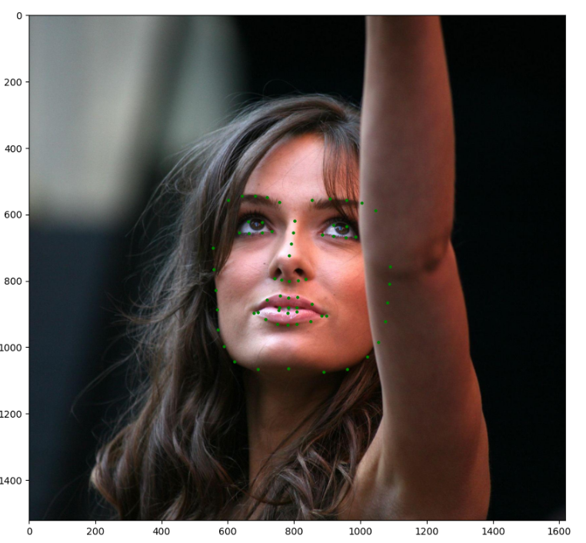
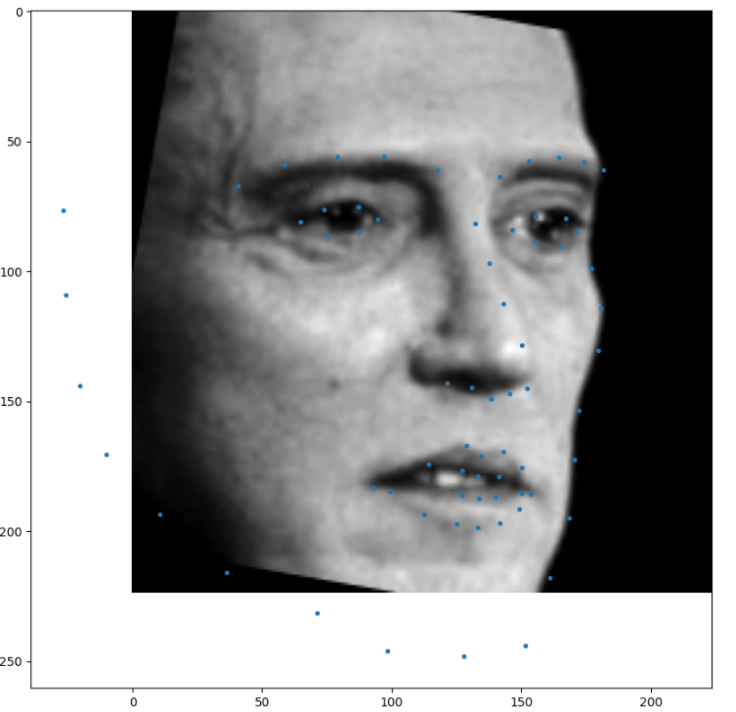
Result
3/21/2024 Annual Review
11

Slide 12
Conclusion
In conclusion, the official DLIB dataset for facial landmark detection is a game-changer in the realm of computer vision and machine learning. With its extensive collection of over 6666 high-quality images, each meticulously annotated with facial landmarks, this dataset stands as a cornerstone for training and refining facial landmark detection models.
What makes this dataset truly remarkable is its diversity. It encompasses a wide array of facial expressions, poses, and environmental settings. This diversity injects richness into the learning process, empowering models to handle real-world scenarios with grace and accuracy.
By providing ground truth annotations for critical facial landmarks, the dataset lays a solid foundation for model development and evaluation. Researchers and practitioners can rely on these annotations to train models that excel in pinpointing facial features, leading to the creation of robust facial analysis systems.
Moreover, the availability of the official DLIB dataset promotes collaboration and fosters innovation within the research community. It serves as a common ground for researchers to compare and refine their methods, pushing the boundaries of what's possible in facial landmark detection.
From facial recognition to emotion analysis, augmented reality, and medical imaging, the applications of this dataset are vast and varied. Its versatility makes it a valuable asset across a spectrum of domains, promising advancements in technology and real-world applications alike.
In essence, the official DLIB dataset is more than just a collection of images; it's a catalyst for progress. Its continued use and exploration will undoubtedly fuel further breakthroughs in understanding and leveraging facial information for the betterment of society and technology.
n
12

